Slide 1
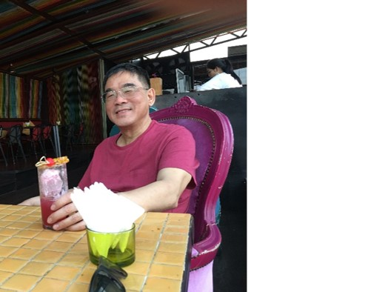
Database Lecture 5
Conceptual Design -
Design Issues
  Addendum
  Dr. Jefferson Fong
  Reference 6.9

Slide 2
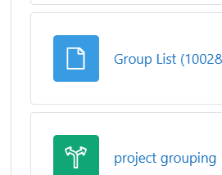
Announcements
Midterm Test
From the survey, Midterm Test will be held on Sat Nov 15, 9:30-11:30.
If you have a legitimate excuse not to take the test at that time, you can apply for an official absentee form from UIC.
Project Groups
Is in iSpace under Section 1002 / 1005
Every group should have at least 1 or 2 people taken System and Web Development workshop.
  Let us know if that’s not so.
Project description due Sun Nov 9.

Slide 3
Reference: [6.9]
In previous lectures, we’ve learned the various tools and mechanisms in ER model.
Now let’s consider the Design Issues
  How to effectively use these ER tools and mechanisms.
Slide 3 Basic design techniques
  2. “Application domain” – if designing DBMS for a bank, don’t change the terminology and class structure for the bank.
Slide 4
  Attribute vs Entity (slides 5-7)
  Entity vs Relationship sets (slides 8-10)
  Strong vs weak entity (slide 11)
  Redundancy (slide 12-13)

Slide 4
Slide 8
Recall ISA from Lecture 4
  The superset (person) is usually at the top.
  Recall Java class; notice in class diagram for inheritance, the arrow points at the opposite direction of the ISA triangle.
Slide 9
Recall Lecture 4, we’ve discuss the ambiguity in ternary relationship.
Slide 11
Recall Lecture 4, weak entity does not have a key.

Slide 5
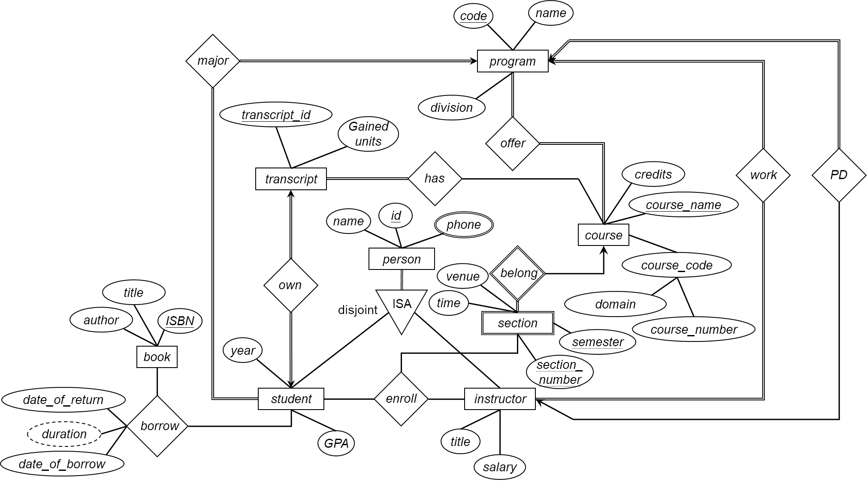
Slide 14 – 15
Slide 15 contains the solution to the Lecture 4 exercise.
Transcript’s Gained units refers to credits completed by a student.
  Gained units is redundant, can be calculated from …
  Then transcript_id useless.
  Can eliminate transcript.
  Show solution from Lec05 Exercise.docx, pg. 14
Ternary enroll relationship, with student/section/instructor can’t handle situation if student takes the class multiple times.
Should change to binary relationships: student enroll section, and instructor teach section.

Slide 6
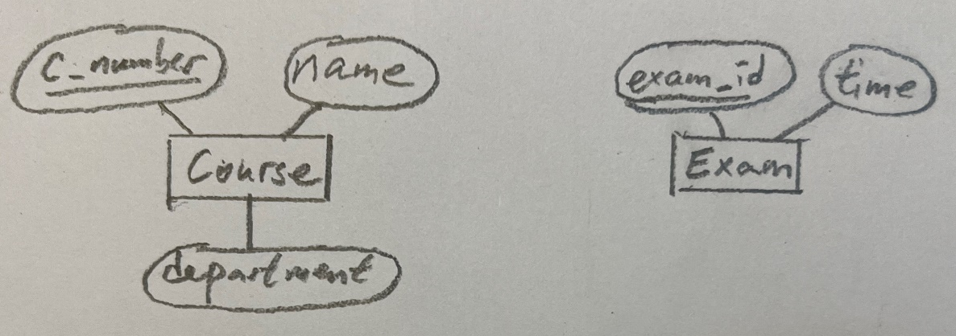
Note: Entities are nouns, and relationships are usually verbs.
  Verify this in the last diagram.
Slide 16
Create entities first, then figure out the relationships between the entities and constraints.
In the Lec05 Exercises.docs, should change relationship “exam location” to “meet at”
Slide 17
ER diagram on Slide 13 cannot satisfy all requirements listed.
So add entity Group to the diagram.
  Student join Group, and Group work on Project.

Slide 7
Summary of ER Diagram Design
Modeling
Constraints
ER Model
Weak Entity
Extended
Design Issue
Design Tech
Practice
To Schema
E
entity set
R
relationship set
A
attribute
E
weak entity set
R
identifying
relationship set
A
multivalued
attribute
R
E
total
participation
many-to-many
relationship
A
derived
attribute
R
R
1..h
E
cardinality
limits
R
many-to-one
relationship
A
primary key
R
role
name
E
role
indicator
one-to-one
relationship
A
R
discriminator
ISA
ISA
ISA
total
generalization
ISA
disjoint
generalization
disjoint

Slide 8
Lecture this week’s lab
  Go through Lab06 up to slide 11 (foreign keys) and addendum.

